Slide 1


Robot Framework
Workshop

Slide 2



Content
About
Basic methods
Requests
Selenium

Slide 3
About

Slide 4








About
Eurofins
group
+ 30.000 employees
30 years of testing experience with best-in-class staff.
375 test laboratories
Fastest growing laboratory network in the world.
Active in + 40 countries
Serving customers all over the world and further expanding our global presence.
€ 2,5 billion revenue
Brilliant financial result in 2016 and year-on-year forecasted growth in the years to follow.
Eurofins Scientific
is an international group of laboratories providing testing and support services to the pharmaceutical, food, environmental and consumer products industries

Slide 5






Quality Assurance
Certification
Acceptance
Eurofins Digital
Testing
What do we do?
Eurofins Digital Testing solutions can serve different objectives across different industries: whether helping you assure your quality or helping you achieve acceptance and certification for your developments. Our expertise and solutions in these domains, will help you get to market even faster and with a higher quality. Whether reaping the benefits of achieving regulatory and contractual obligations, achieving higher customer satisfaction or significantly reducing your maintenance costs, you will always achieve your quality targets with Eurofins on board!

Slide 6



Our offering
In everything we do for you, you can chose between a custom made or an off-the-shell approach.
QA Services
Benefit from our unparalleled expertise in end-to-end quality assurance. We will guide you in every phase in the lifecycle of your product or service.
Tools
You can experience our best-in-class test tools for device conformance, functional testing, and performance testing.
Staffing
Get to market more quickly by using our insourcing approach, where our test experts and managers support you onsite.

Slide 7

Performance
Compliance
Functionality
Stability
Security
Testing types
Compatibility
Our
Testing services
QA & test consultancy
Test lab setup
Test management
Test automation scripting
Test management tooling
Manual & automated test execution
Service at its best!
We provide professional services by trained experts on-site, off-site or nearshore. You have a wide selection of off-the-shelf services or custom services especially tailored for your company.
Test analysis & test design
Automated operational monitoring

Slide 8



Our
Testing
tools
Off-the-shelf
Our testing tools are best in class developed by passionate teams with a focus on high quality in evolving market requirements.
Custom made
We can develop new or make modifications to our existing conformance or automation test tools.
What best suites our customer!

Slide 9





Test automation
is key
Increase speed of development
Ensure quality requirements
Level up your productivity
Test automation increases the speed of product developments and release cycles. It improves the focus of manual resources which results in better productivity. Above all, test automation makes sure your end product or service works as expected.

Slide 10





Media distribution
The roots of the business go way back in the media industry and are the core of the company.
Internet of Things
With our smart home proposition we bring testing in IoT to a whole new level
Our core markets
The company's deep understanding of quality assurance in the digital landscape gives the opportunity to spread our services over several industries.
Connected car
Unparalleled service in certification and interoperability testing
Connected health
Eurofins has over 20 years of experience in the health industry
Notes:
Stippellijntjes staan wat moeilijk.

Slide 11




Our services
& tools
Custom services
The services can be rendered in an Eurofins lab or on location of the customer (e.g. QA consultancy or hard- & software testing)
Custom tools
We can develop from the ground up or starting from an existing product which has custom changes developed for it.
Off-the-shelf services
Typical examples of these services include, certification & conformance tests (e.g. country approvals or standard certifications)
Off-the-shelf tools
Off-The-Shelf products are generally standard and off-price list (catalogue) products with limited customization required.
Custom versus off-the-shelf
Custom services and tools are profiled to customer specific requirements whilst off-the-shelf services and tools are generally standard with limited or zero customization required.

Slide 12

Frameworks
Technologies
Test Automation
Starters
Interns
Coaching
Workshops & Tutoring
Coordination
Sepp Van Cauwenbergh
Technical Coach

Slide 13

Robot Framework

Slide 14
Generic test automation framework
Written in python
Keyword driven
.robot extension
About Robot framework
General

Slide 15
Robot framework tests are written using a text editor
Tests are executed using command line
i.e. robot filename.robot
Reporting is done via Robot Framework with .html files
About Robot framework
General

Slide 16
Install Python https://www.python.org/downloads/release/python-2714/
Add path variables of Python & Python scrips i.e. C:\Python27 & C:\Python27\Scripts
Add libraries with pip install:
Open cmd & enter the following commands:
pip install Robotframework
pip install DateTime
pip install requests
pip install robotframework-requests
pip install robotframework-jsonlibrary
pip install robotframework-seleniumlibrary
About Robot framework
Installation

Slide 17
Eurofins recommends Visual Studio Code, but any text editor can be used.
Install Visual Studio Code https://code.visualstudio.com/
Open Visual Studio Code and press ctrl + shift + P
Enter Extensions: Install Extensions Install the following extensions: Robot Framework Intellisense robot framework language
About Robot framework
Installation

Slide 18
Basic script

Slide 19
Robot Framework uses unique syntax to define tests
Keyword driven
Double spacing (!) between keywords
Variables not bound to one datatype
Syntax
Robot Framework syntax

Slide 20
Exercise 0
Create a folder “Exercise0”
Create a new file “Exercise0.robot”
Add the following 3 lines of code to the file
*** Test Cases ***
Hello World
Log Hello World!
Syntax
Hello World

Slide 21
A .robot file can be executed using a command line tool:
robot pathToFile\Filename.robot
Runs one test
robot pathToFiles
Runs all robot files in the folder
Executing tests

Slide 22
Once a .robot file is executed 3 files will be generated in the directory where the command line was executed
log.html
output.xml
report.xml
Best practice:
Don’t run execute tests from the same directory as the test cases. Use a dedicated /Reports folder
Executing tests

Slide 23
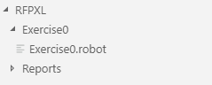
Exercise 0 – execution
Create a folder “Reports”
Open reports in cmd
Start the robot script
robot ..\Exercise0\Exercise0.robot
Syntax
Hello World

Slide 24
Basic methods

Slide 25
\Robot Framework\RFTraining\Examples\SyntaxExample.robot
*** Settings ***
Resource ./Resources/ExampleResource.robot
*** Variables ***
${Message}= Hello World!
*** Keywords ***
Multiply numbers
[Documentation] This keyword multiplies 2 numbers, logs & returns the result
[Arguments] ${number1} ${number2}
${result}= Evaluate ${number1} * ${number2}
Log ${result}
[Return] ${result}
*** Test Cases ***
Test case 1
[Tags] Sanity Test
Log ${Message}
${result}= Multiply numbers ${3} ${5}
Log ${result}
#This line is a comment
${result}= Add two strings String1 String2
Log ${result}
Syntax
Example script

Slide 26
Within a robot file several sections can be defined:
*** Settings ***
This section contains references to libraries & resources available in the script
Suite Setup & Suite Teardown is also used here
*** Variables ***
Initialize any global variables to be used in the script
*** Keywords ***
Create custom keywords to be used in the script
*** Test Cases ***
Collection of the test cases to be executed when running the script
Syntax
Test case syntax

Slide 27
Several keywords are already defined to help testers script their tests
http://robotframework.org/robotframework/
http://robotframework.org/robotframework/latest/libraries/BuiltIn.html
http://robotframework.org/robotframework/latest/libraries/Collections.html
Syntax
Test case syntax

Slide 28
\Training\Robot Framework\RFTraining\Examples\LogicExamples.robot
While robot framework is keyword driven, a lot of logic can be built into keywords and tests
If Statement
[Tags] if
[Documentation] This test case demonstrates an if statement
${life}= Set Variable ${30}
Run keyword if ${life} == ${42} Log "The answer to the ultimate question" ELSE Log "Try again"
${life}= Run keyword unless ${life} == ${42} Set variable ${42}
Run keyword if ${life} == ${42} Log "The answer to the ultimate question" ELSE Log "Try again"
Logic statements

Slide 29
\Training\Robot Framework\RFTraining\Examples\LogicExamples.robot
For Loop Test
[Tags] for
[Documentation] This test case demonstrates a for loop
:FOR ${i} IN RANGE ${10}
\ Log ${i}
${list}= Create list String1 String2 String3 String4
:FOR ${item} IN ${list}
\ Log ${item}
:FOR ${item} IN @{list}
\ Log ${item}
Logic statements

Slide 30
\Training\Robot Framework\RFTraining\Examples\LogicExamples.robot
Passing Tests
[Tags] result
[Documentation] This test case will always pass
Pass Execution This keyword will pass the test case and skip the rest of the test case
Log This keyword is not executed
Failing Tests
[Tags] result
[Documentation] This test case will always fail
${exampleString}= Set variable This is an example string
Should be empty ${exampleString}
Length should be ${exampleString} ${26}
Should be true ${FALSE}
Should be equal ${exampleString} Another string
Fail This keyword immediately fails the test case
Log The end of the test case
Passing / Failing Tests

Slide 31
\Training\Robot Framework\RFTraining\Examples\LogicExamples.robot
Keywords can have optional parameters
Optional parameters
[Documentation] Keyword with optional parameters
[Arguments] ${arg1} ${optionalValue}=Default
Log ${arg1} ${optionalValue}
Keywords can return several values
Multiple returns
[Documentation] Keyword with mutliple returns
[Return] ${1} ${2} ${3}
Multiple return values can stored as list or single values
${list}= Multiple returns
${return1} ${return2} ${return3}= Multiple returns
Logic statements

Slide 32
A .robot file can be executed using a command line tool:
robot pathToFile\Filename.robot
Runs one test
robot pathToFiles
Runs all robot files in the folder
Tests can be included or excluded from a run based on tags by --include or --exclude
robot --include Tag pathToFile\Filename.robot
Variables can be set when executing tests with --variable
robot --variable name:value pathToFile\Filename.robot
Executing a test suite

Slide 33
Create a test case which gets the current time
Verify whether the year starts with “20”
Tips:
http://robotframework.org/robotframework/latest/libraries/DateTime.html
http://robotframework.org/robotframework/latest/libraries/BuiltIn.html
Exercise 1

Slide 34
Robot Framework is compatible with a lot of libraries
Official libraries: BuiltIn, Operating System, Collections, Strings…
External Libraries: Selenium, Requests, SSHLibrary…
Underlying Python code formatted into Keywords
Imported at *** Settings ***
Libraries
General

Slide 35
Requests

Slide 36
Commonly used library
REST requests
Uses easy syntax to send requests:
Create session
Get Request
https://bulkan.github.io/robotframework-requests/
Requests
General

Slide 37
\Robot Framework\RFTraining\Examples\RequestExample.robot
*** Settings ***
Library RequestsLibrary
Library JSONLibrary
*** Test Cases ***
Get Example
Create session APIUt http://postcodes.io
${response}= Get request APIUt /random/postcodes
Log ${response.status_code} ${response.text}
${response}= To Json ${response.text}
${result}= Get value from json ${response} $.result.postcode
Log ${result}
Post Example
Create session APIUt http://postcodes.io
${request}= Set variable {"postcodes" : ["OX49 5NU", "M32 0JG", "NE30 1DP"]}
&{headers}= Create Dictionary Content-Type=application/JSON
${response}= Post request APIUt /postcodes data=${request} headers=${headers}
Log ${response.status_code} ${response.text}
Requests
Example

Slide 38
Create a test case which gets a random postcode, validates this postcode and checks if this postcode is terminated or not.
Fail the test if the post code is not valid or if it’s terminated.
Tips:
Libraries needed: RequestsLibrary, JSONLibrary, Collections
API info can be found at http://postcodes.io/
Exercise 2

Slide 39
To increase maintainability and readability of test scripts additional keywords can be made and put into a seperate resource file.
Typically a test case will feature as little logic as possible
Resource files do not contain any validation.
https://bulkan.github.io/robotframework-requests/
Keywords
General

Slide 40
Rework exercise 2 but separate any logic into a resource file and all validation is triggered from the actual test suite.
Tips:
3 keywords are needed:
Get Random Postcode
Validate Postcode
Validate Terminated Code
Ensure keywords do not assume the status of the postcode
Exercise 3

Slide 41
Selenium

Slide 42
Library for browser automation
Interacts with elements on a web page
Robot Framework provides easy syntax
http://robotframework.org/SeleniumLibrary/SeleniumLibrary.html
Selenium
General
WebDriverException: Message: 'chromedriver' executable needs to be in PATH. Please see https://sites.google.com/a/chromium.org/chromedriver/home

Slide 43
Locate element
Interact with element
Elements can be found on a page using several selectors
id
xpath
css selector
class
link
…
Selenium
General

Slide 44
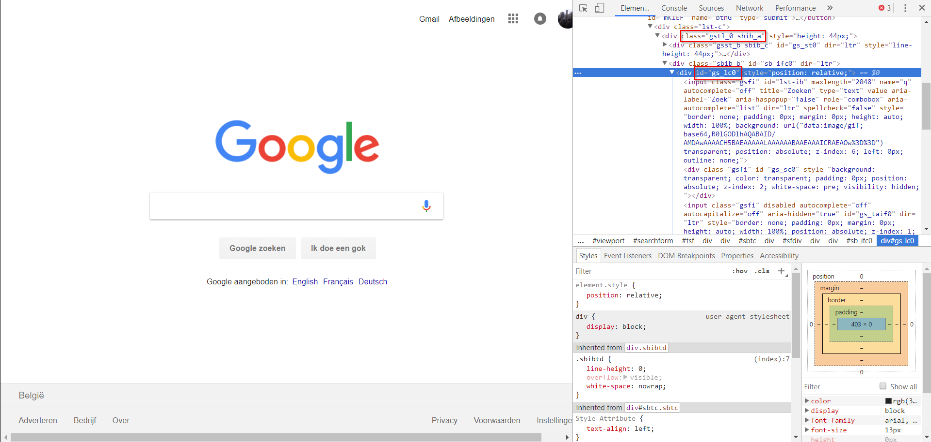
Selectors can be found in the source code of a page
Right mouse button → copy xpath
Selenium
Selectors

Slide 45
*** Settings ***
Library SeleniumLibrary
Suite Setup open Browser http://www.google.be Google Chrome
Suite Teardown Close browser
*** Test Cases ***
Google search
[Documentation] This test case will search for "Graspop Metal Meeting" using Google and clicks the first link
Input Text id:lst-ib Graspop Metal Meeting
${searchButton}= Set variable xpath://*[@id="sbtc"]/div[2]/div[2]/div[1]/div/ul/li[11]/div/span[1]/span/input
Wait Until Page Contains Element ${searchButton} 5s
Click element ${searchButton}
Click element link:Graspop Metal Meeting 2018
Sleep 5s
Selenium
General

Slide 46
Go to youtube, search a video and log the amount of results.
Watch a video, close the browser after the video is over.
Create keywords using resources
Tips:
Build in a Sleep based on the length of the video
Length is displayed at the bottom of the video
Exercise 4

Slide 47
Tips:
Google often follows their own programming rules
→ Double IDs
→ Compound class names
IDs might not work
i.e. 4 elements have “search” as id
→ xpath://*[@id="search-input"]/input
→ xpath://*[@id="search"]/form/div/div/div/div[2]/input (after hover)
Exercise 4

Slide 48
Go to https://testlabcafe.be
Test the following login test cases:
No username / no pw
Username / no pw
Username / incorrect pw
Username / correct pw → logout
Verify the error messages in case of incorrect login
Verify the title of the page in case of correct login
Exercise 5

Slide 49
Tips:
Make one resource per area: Login.robot & Home.robot
Force sleep
Check for the presence of error messages with Get element count
Use keywords to get the error messages
Exercise 5

Slide 50


Thank you for your attention
Questions?

